Slide 1
Image Segmentation
Image segmentation is the operation of partitioning an
image into a collection of connected sets of pixels.
1. into regions, which usually cover the image
2. into linear structures, such as
- line segments
- curve segments
3. into 2D shapes, such as
- circles
- ellipses
- ribbons (long, symmetric regions)

Slide 2
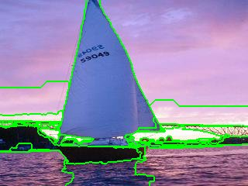
Example 1: Regions

Slide 3
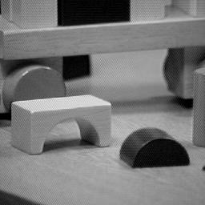
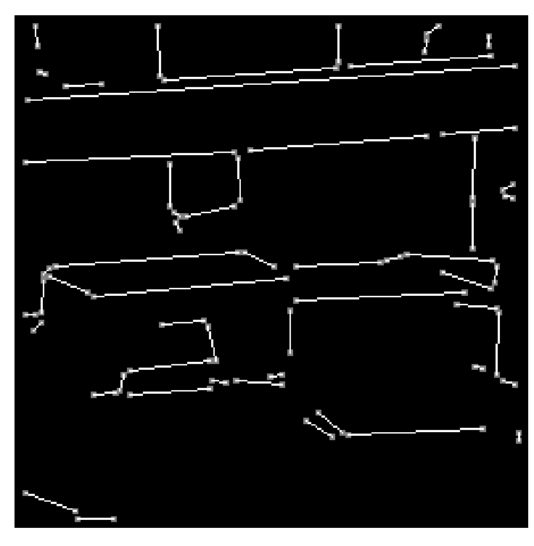
Example 2:
Straight Lines

Slide 4
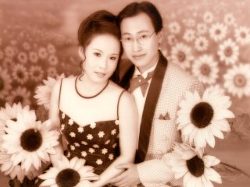
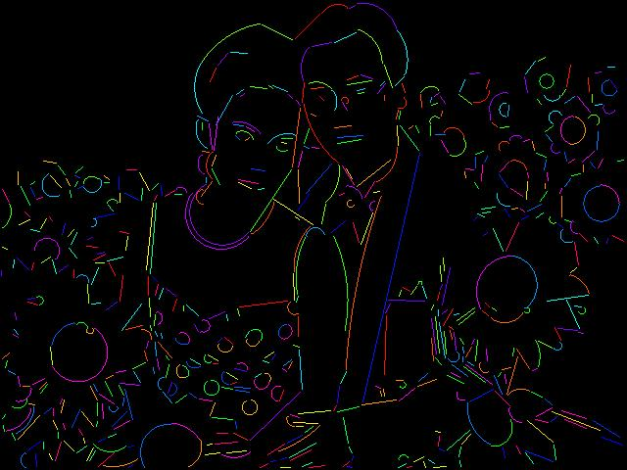
Example 3:
Lines and Circular Arcs

Slide 5
Region Segmentation:
Segmentation Criteria
From Pavlidis
A segmentation is a partition of an image I into
a set of regions S satisfying:
1. ∪ Si = S Partition covers the whole image.
2. Si ∩ Sj = φ, i ≠ j No regions intersect.
3. ∀ Si, P(Si) = true Homogeneity predicate is
satisfied by each region.
4. P(Si ∪ Sj) = false, Union of adjacent regions
i ≠ j, Si adjacent Sj does not satisfy it.

Slide 6
So
So all we have to do is define and implement the
similarity predicate.
But, what do we want to be similar in each region?
Is there any property that will cause the regions to
be meaningful objects?

Slide 7
Main Methods of Region Segmentation
1. Region Growing
2. Clustering
3. Split and Merge

Slide 8
Region Growing
Region growing techniques start with one pixel of a
potential region and try to grow it by adding adjacent
pixels till the pixels being compared are too disimilar.
The first pixel selected can be just the first unlabeled
pixel in the image or a set of seed pixels can be chosen
from the image.
Usually a statistical test is used to decide which pixels
can be added to a region.

Slide 9
The RGGROW Algorithm
Let R be the N pixel region so far and P be a neighboring
pixel with gray tone y.
Define the mean X and scatter S (sample variance) by
X = 1/N ∑ I(r,c)
S = 1/N ∑ (I(r,c) - X)
2
(r,c) ∈ R
2
2
(r,c) ∈ R

Slide 10
The RGGROW Statistical Test
The T statistic is defined by
(N-1) * N
T = -------------- (y - X) / S
(N+1)
1/2
2
2
It has a T distribution if all the pixels in R and the
test pixel y are independent and identically distributed
normals (IID assumption) .
N-1

Slide 11
Decision and Update
For the T distribution, statistical tables give us the
probability Pr(T ≤ t) for a given degrees of freedom
and a confidence level. From this, pick suitable
threshold t.
If the computed T ≤ t for desired confidence level,
add y to region R and update X and S .
If T is too high, the value y is not likely to have arisen
from the population of pixels in R. Start a new region.
2

Slide 12
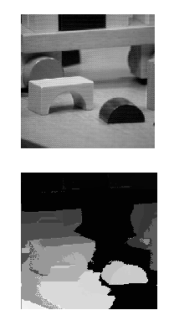
RGGROW Example
image
Not great!
segmentation
What do you think this would
do on wallpaper texture?

Slide 13
Clustering
There are K clusters C1,…, CK with means m1,…, mK.
The least-squares error is defined as
Out of all possible partitions into K clusters,
choose the one that minimizes D.
K
2
D = ∑ ∑ || xi - mk || .
k=1 xi ∈ Ck
Why don’t we just do this?
If we could, would we get meaningful objects?

Slide 14
Some Clustering Methods
K-means Clustering and Variants
Isodata Clustering
Histogram-Based Clustering and Recursive Variant
Graph-Theoretic Clustering

Slide 15
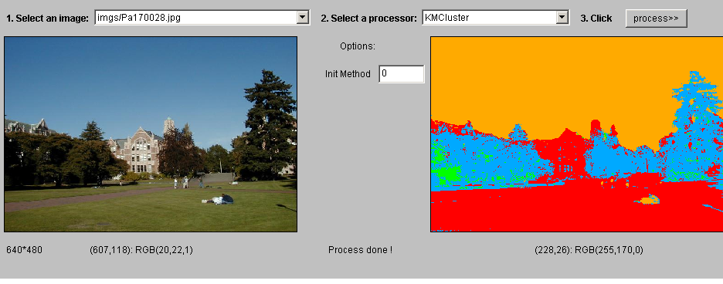
K-Means Example 1

Slide 16
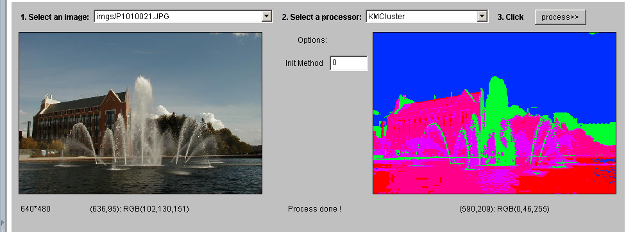
K-Means Example 2

Slide 17
Meng-Hee Heng’s K-means Variant
1. Pick 2 points Y and Z that are furthest apart in the
measurement space and make them initial cluster means.
2. Assign all points to the cluster whose mean they are
closest to and recompute means.
3. Let d be the max distance from each point to its cluster mean
and let X be the point with this distance.
4. Let q be the average distance between each pair of means.
5. If d > q / 2, make X a new cluster mean.
6. If a new cluster was formed, repeat from step 2.

Slide 18
Illustration of Heng Clustering
We used this for segmentation of textured scenes.
1
2
3
Y
q
X
D>q/2
Z

Slide 19
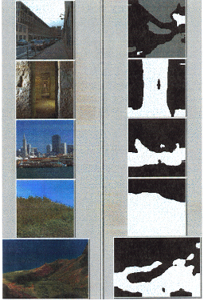
Heng Clustering with Texture Feature

Slide 20
Isodata Clustering
1. Select several cluster means and form clusters.
2. Split any cluster whose variance is too large.
3. Group together clusters that are too small.
4. Recompute means.
5. Repeat till 2 and 3 cannot be applied.
We used this to cluster normal vectors in 3D data.

Slide 21
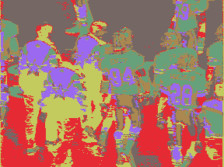
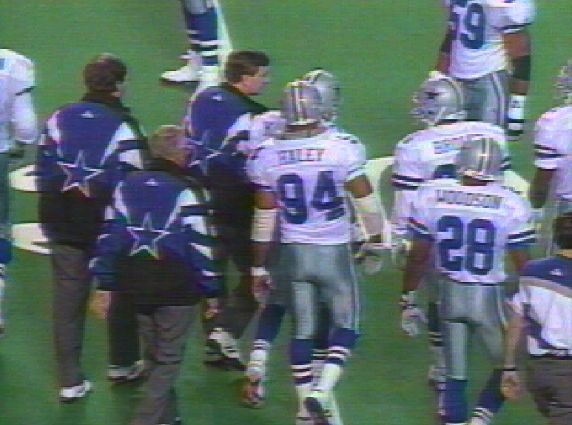
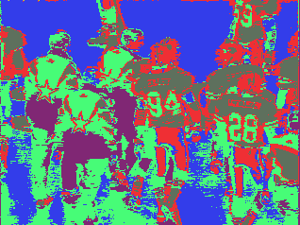
Comparison
K-means, K=6
Isodata, K became 5
Original

Slide 22
Ohlander’s Recursive Histogram-Based Clustering
color images of real indoor and outdoor scenes
starts with the whole image
selects the R, G, or B histogram with largest peak
and finds clusters from that histogram
converts to regions on the image and creates masks for each
pushes each mask onto a stack for further clustering

Slide 23
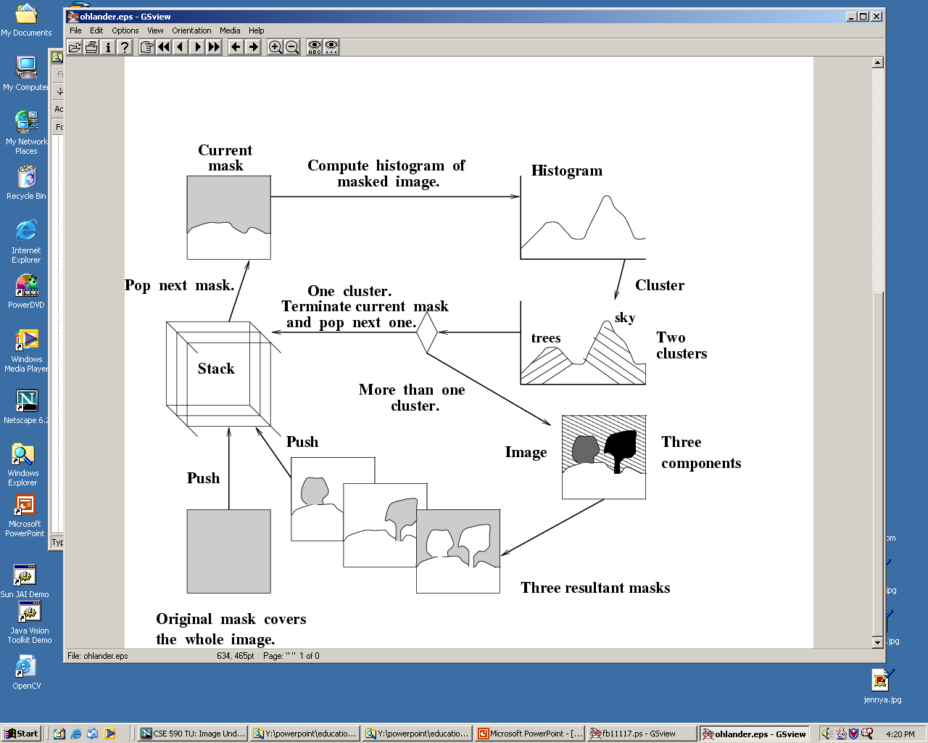
Ohlander’s Method
Ohta suggested using
(R+G+B)/3, (R-B)/2
and (2G-R-B)/4 instead
of (R, G, B).
separate
R, G, B
tree2
tree1
sky

Slide 24
Jianbo Shi’s Graph-Partitioning
An image is represented by a graph whose nodes
are pixels or small groups of pixels.
The goal is to partition the vertices into disjoint sets so
that the similarity within each set is high and
across different sets is low.

Slide 25
Minimal Cuts
Let G = (V,E) be a graph. Each edge (u,v) has a weight w(u,v)
that represents the similarity between u and v.
Graph G can be broken into 2 disjoint graphs with node sets
A and B by removing edges that connect these sets.
Let cut(A,B) = ∑ w(u,v).
One way to segment G is to find the minimal cut.
uεA, vεB

Slide 26
Cut(A,B)
cut(A,B) = ∑ w(u,v).
uεA, vεB
B
A
w1
w2

Slide 27
Normalized Cut
Minimal cut favors cutting off small node groups,
so Shi proposed the normalized cut.
cut(A, B) cut(A,B)
Ncut(A,B) = ------------- + -------------
asso(A,V) asso(B,V)
normalized
cut
asso(A,V) = ∑ w(u,t)
u∈A, t∈V
How much is A connected
to the graph as a whole.

Slide 28
Example Normalized Cut
A
B
2
2
2
2
2
2
2
2
1
4
3
1
2
2
2
3
3 3
Ncut(A,B) = ------- + ------
21 16

Slide 29
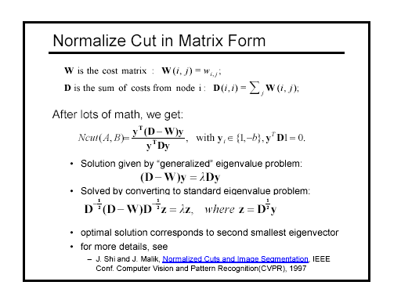

Slide 30
How Shi used the procedure
Shi defined the edge weights w(i,j) by
w(i,j) = e *
||X(i)-X(j)||2 / σX
||F(i)-F(j)||2 / σI
e if ||X(i)-X(j)||2 < r
0 otherwise
where X(i) is the spatial location of node i
F(i) is the feature vector for node I
which can be intensity, color, texture, motion…
The formula is set up so that w(i,j) is 0 for nodes that
are too far apart.

Slide 31
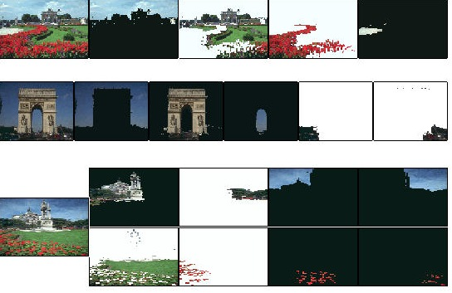
Examples of
Shi Clustering
See Shi’s Web Page
http://www-2.cs.cmu.edu/~jshi

Slide 32
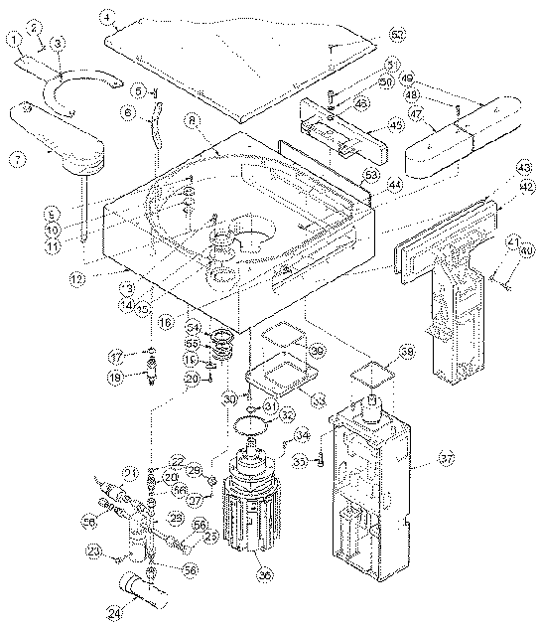
Lines and Arcs
Segmentation
In some image sets, lines, curves, and circular arcs
are more useful than regions or helpful in addition
to regions.
Lines and arcs are often used in
object recognition
stereo matching
document analysis

Slide 33
Edge Detection
Basic idea: look for a neighborhood with strong signs
of change.
Problems:
neighborhood size
how to detect change
81 82 26 24
82 33 25 25
81 82 26 24

Slide 34
Differential Operators
Differential operators
attempt to approximate the gradient at a pixel via masks
threshold the gradient to select the edge pixels

Slide 35
Example: Sobel Operator
-1 0 1 1 2 1
Sx = -2 0 2 Sy = 0 0 0
-1 0 1 -1 -2 -1
On a pixel of the image
let gx be the response to Sx
let gy be the response to Sy
2
2
1/2
Then g = (gx + gy ) is the gradient magnitude.
θ = atan2(gy,gx) is the gradient direction.

Slide 36
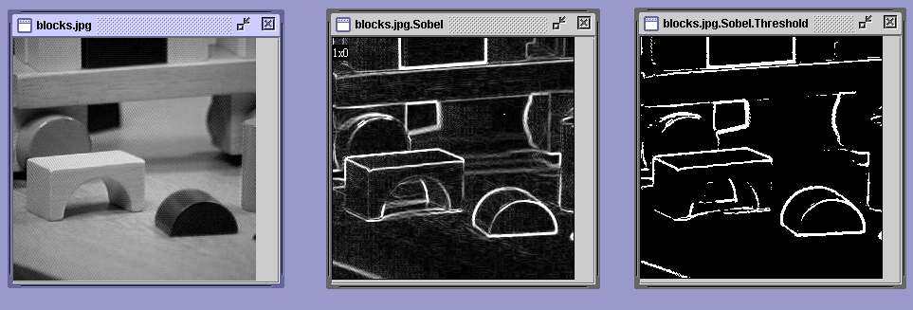
Java Toolkit’s Sobel Operator
original image gradient thresholded
magnitude gradient
magnitude

Slide 37
Zero Crossing Operators
Motivation: The zero crossings of the second derivative
of the image function are more precise than
the peaks of the first derivative.
step edge
smoothed
1st derivative
zero crossing
2nd derivative

Slide 38
Marr/Hildreth Operator
First smooth the image via a Gaussian convolution
Apply a Laplacian filter (estimate 2nd derivative)
Find zero crossings of the Laplacian of the Gaussian
This can be done at multiple resolutions.

Slide 39
Haralick Operator
Fit the gray-tone intensity surface to a piecewise
cubic polynomail approximation.
Use the approximation to find zero crossings of the
second directional derivative in the direction that
maximizes the first directional derivative.
The derivatives here are calculated from direct
mathematical expressions wrt the cubic polynomial.

Slide 40
Canny Edge Detector
Smooth the image with a Gaussian filter.
Compute gradient magnitude and direction at each pixel of
the smoothed image.
Zero out any pixel response ≤ the two neighboring pixels
on either side of it, along the direction of the gradient.
Track high-magnitude contours.
Keep only pixels along these contours, so weak little
segments go away.

Slide 41
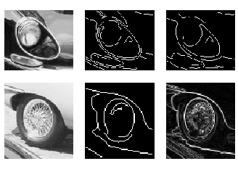
Canny Examples

Slide 42
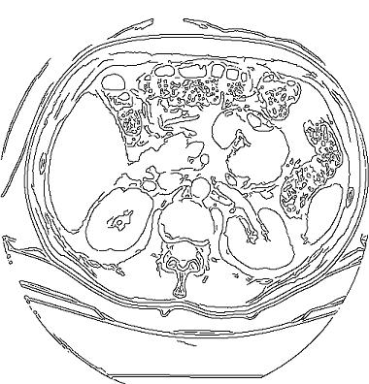
Best Canny on Kidney from Hw1

Slide 43
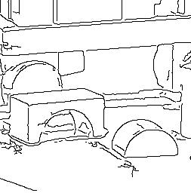
Best Canny on Blocks from Hw1

Slide 44
Finding Line and Curve Segments from Edge Images
Given an edge image, how do we find line and arc segments?
Method 1: Tracking
Use masks to identify the following events:
1. start of a new segment
2. interior point continuing a segment
3. end of a segment
4. junction between multiple segments
5. corner that breaks a segment into two
junction
corner

Slide 45
Edge Tracking Procedure
for each edge pixel P {
classify its pixel type using masks
case
1. isolated point : ignore it
2. start point : make a new segment
3. interior point : add to current segment
4. end point : add to current segment and finish it
5. junction or corner : add to incoming segment
finish incoming segment
make new outgoing segment(s)
The ORT package uses a fancier corner finding approach.

Slide 46
Hough Transform
The Hough transform is a method for detecting
lines or curves specified by a parametric function.
If the parameters are p1, p2, … pn, then the Hough
procedure uses an n-dimensional accumulator array
in which it accumulates votes for the correct parameters
of the lines or curves found on the image.
image
accumulator
b
m
y = mx + b

Slide 47
Finding Straight Line Segments
y = mx + b is not suitable (why?)
The equation generally used is: d = r sin θ + c cos θ
c
θ
d
d is the distance from the line to origin
θ is the angle the perpendicular makes
with the column axis
r

Slide 48
Procedure to Accumulate Lines
Set accumulator array A to all zero.
Set point list array PTLIST to all NIL.
For each pixel (R,C) in the image {
compute gradient magnitude GMAG
if GMAG > gradient_threshold {
compute quantized tangent angle THETAQ
compute quantized distance to origin DQ
increment A(DQ,THETAQ)
update PTLIST(DQ,THETAQ) } }

Slide 49
Example
gray-tone image
DQ
THETAQ
0 0 0 100 100
0 0 0 100 100
0 0 0 100 100
100 100 100 100 100
100 100 100 100 100
- - 3 3 -
- - 3 3 -
3 3 3 3 -
3 3 3 3 -
- - - - -
- - 0 0 -
- - 0 0 -
90 90 40 20 -
90 90 90 40 -
- - - - -
Accumulator A
PTLIST
360
.
6
3
0
- - - - - - -
- - - - - - -
- - - - - - -
4 - 1 - 2 - 5
- - - - - - -
360
.
6
3
0
- - - - - - -
- - - - - - -
- - - - - - -
* - * - * - *
- - - - - - -
(3,1)
(3,2)
(4,1)
(4,2)
(4,3)
distance
angle
0 10 20 30 40 …90
(1,3)(1,4)(2,3)(2,4)

Slide 50
How do you extract the line segments from the accumulators?
pick the bin of A with highest value V
while V > value_threshold {
order the corresponding pointlist from PTLIST
merge in high gradient neighbors within 10 degrees
create line segment from final point list
zero out that bin of A
pick the bin of A with highest value V }

Slide 51
Finding Circles
r = r0 + d sin θ
c = c0 + d cos θ
r, c, d are parameters
Equations:
Main idea: The gradient vector at an edge pixel points
to the center of the circle.
d
*(r,c)

Slide 52
Why it works
Filled Circle:
Outer points of circle have gradient
direction pointing to center.
Circular Ring:
Outer points gradient towards center.
Inner points gradient away from center.
The points in the away direction don’t
accumulate in one bin!

Slide 53
Procedure to Accumulate Circles
Set accumulator array A to all zero.
Set point list array PTLIST to all NIL.
For each pixel (R,C) in the image {
For each possible value of D {
- compute gradient magnitude GMAG
- if GMAG > gradient_threshold {
. Compute THETA(R,C,D)
. R0 := R - D*cos(THETA)
. C0 := C - D* sin(THETA)
. increment A(R0,C0,D)
. update PTLIST(R0,C0,D) }}

Slide 54
The Burns Line Finder
3
2
45
3
4
2
+22.5
4
1
0
5
1
5
8
6
7
6
7
8
-22.5
1. Compute gradient magnitude and direction at each pixel.
2. For high gradient magnitude points, assign direction labels
to two symbolic images for two different quantizations.
3. Find connected components of each symbolic image.
Each pixel belongs to 2 components, one for each symbolic image.
Each pixel votes for its longer component.
Each component receives a count of pixels who voted for it.
The components that receive majority support are selected.

Slide 55
See Transparencies

